Slide 1
Geographical Data
Nowadays, you would hardly come across a dashboard that does not contain a map-based visualization.
Using a Power BI map is a great way to visualize data that represent locations.
The Map visual maps out data points that have longitude and latitude coordinates as their values.
Power BI integrates with Bing Maps to provide default map coordinates.
You can include a third dimension to this visual by representing the data points using shapes, bubbles (circles), where the size of each bubble is represented by the value of your third dimension.

Slide 2
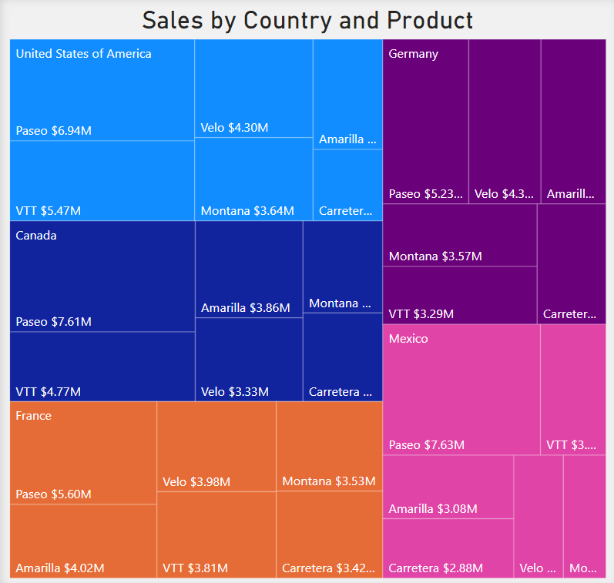
Treemap
Treemaps display hierarchical data set in a nested rectangle. At each level, hierarchy is represented by a color. The size of the space in the rectangle depends on the data values. The rectangular boxes are arranged in size from top left to bottom right.
The levels of the hierarchy are represented by a colored rectangle also known as the branch. The rectangles within the rectangles further categorize the data and are known as the leaves. The size of each rectangle is determined by a metric and are ordered from largest to smallest.

Slide 3
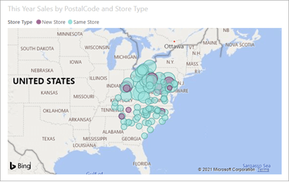
Basic Map
You can use a basic map to display both categorical and quantitative information based on geographical locations.
This type of map is best for basic display.
There’s not much customization you can do as this is only good for common uses.

Slide 4
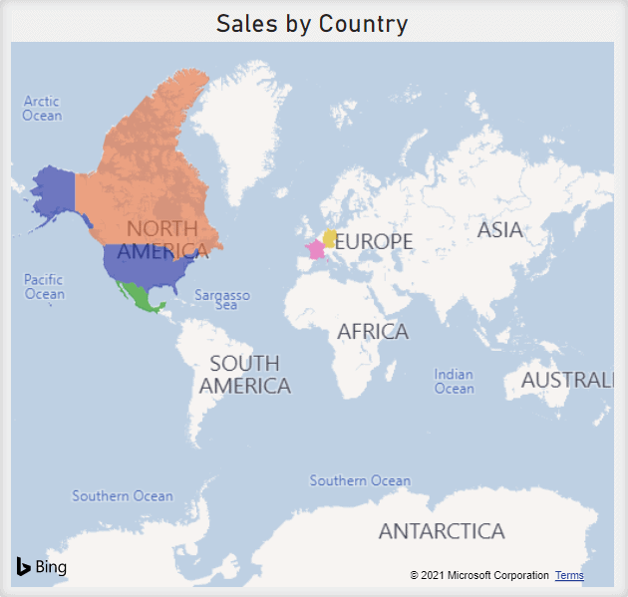
Filled Map
A filled map, also known as a choropleth map, shows shaded geographic areas.
Filled Map is a map that shows data points as Geo-spatial areas rather than points on map. Areas can be continent, country, region.
The Filled Map visual displays how a value differs in proportion across geography or region by the use of shading, tinting, or patterns.

Slide 5
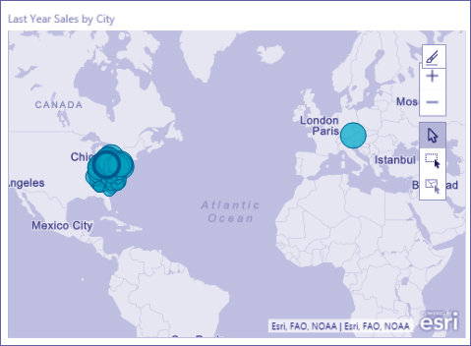
ArcGIS Map
ArcGIS (Geographic Information Systems) maps are more advanced than your typical basic map. This type of map includes features not found in others like clustering.
Clustering feature as you zoom in or out.
The ArcGIS Map displays data points on a map referencing values.
The ArcGIS Map to create maps of deeper understanding using the themes.

Slide 6
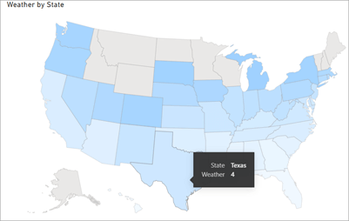
Shape Map
A shape Map is used to show relative comparisons of different regions on a map using different colors.
This is a type of map that shows polygon shapes on the canvas with a blank background.
You can’t use a Shape map to display precise geographical locations of data points on a map.
A shape map varies with the other maps in a lot of ways including having built-in geographies and the ability to import custom shapes using the TopoJSON format.

Slide 7
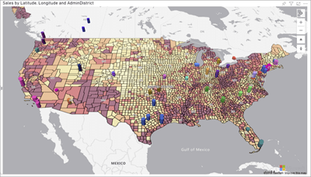
Azure Map
The Azure Map in Power BI can be used to gain insights into the location context of your business.
The Azure Maps Power BI visual provides a rich set of data visualizations for spatial data on top of a map.

